Slide 1
ANTLR 4
(ANother Tool for Language Recognition) is a parser generator that can read, process, execute, or translate structured text or binary files. It's used to build languages, tools, and frameworks in academia and industry. For example, Twitter uses ANTLR to parse search queries.
ANTLR provides access to language processing primitives like lexers, grammars, and parsers, as well as the runtime to process text against them. From a grammar, ANTLR generates a parser that can build and walk parse trees. ANTLR uses a LL(*) algorithm for parsing.

Slide 2
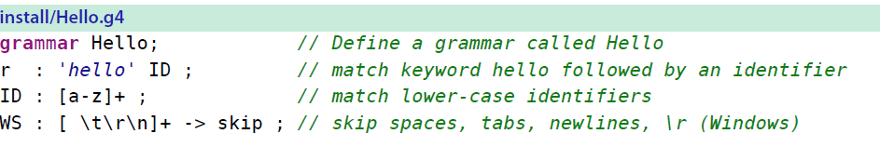
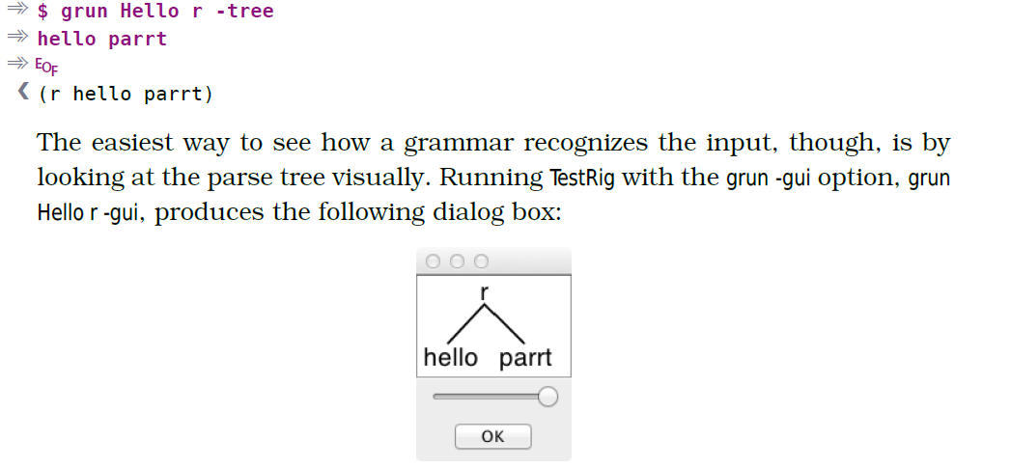

Slide 3
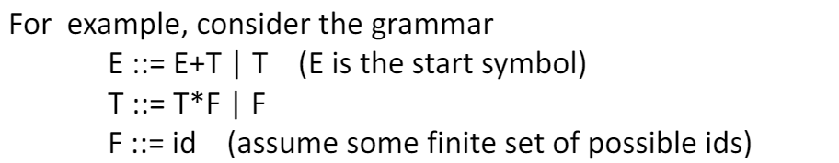
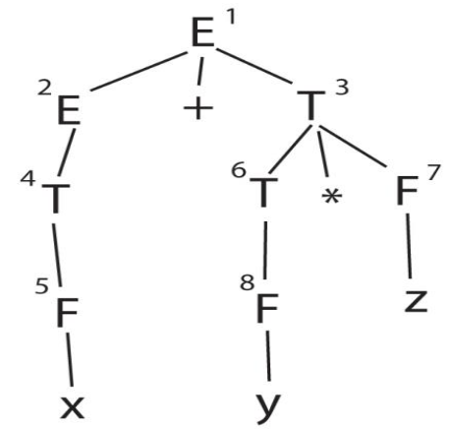
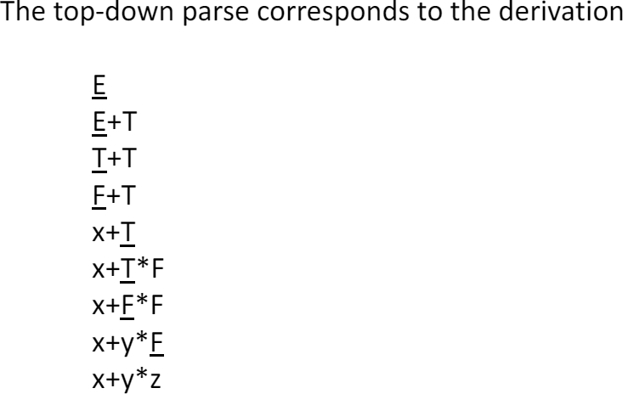
TOP DOWN PARSING (LL PARSING) Recursive Descent

Slide 4
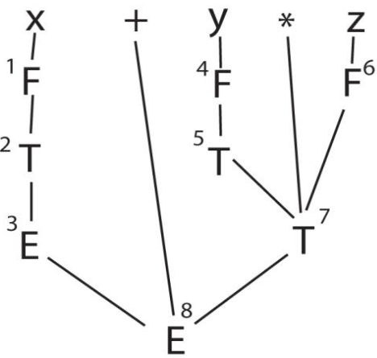
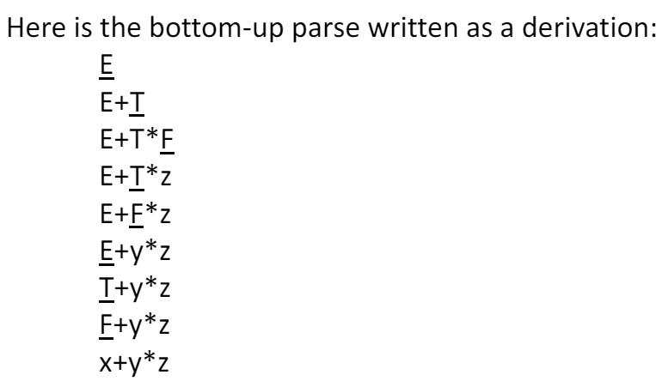
BOTTOM UP PARSING (LR PARSING)

Slide 5
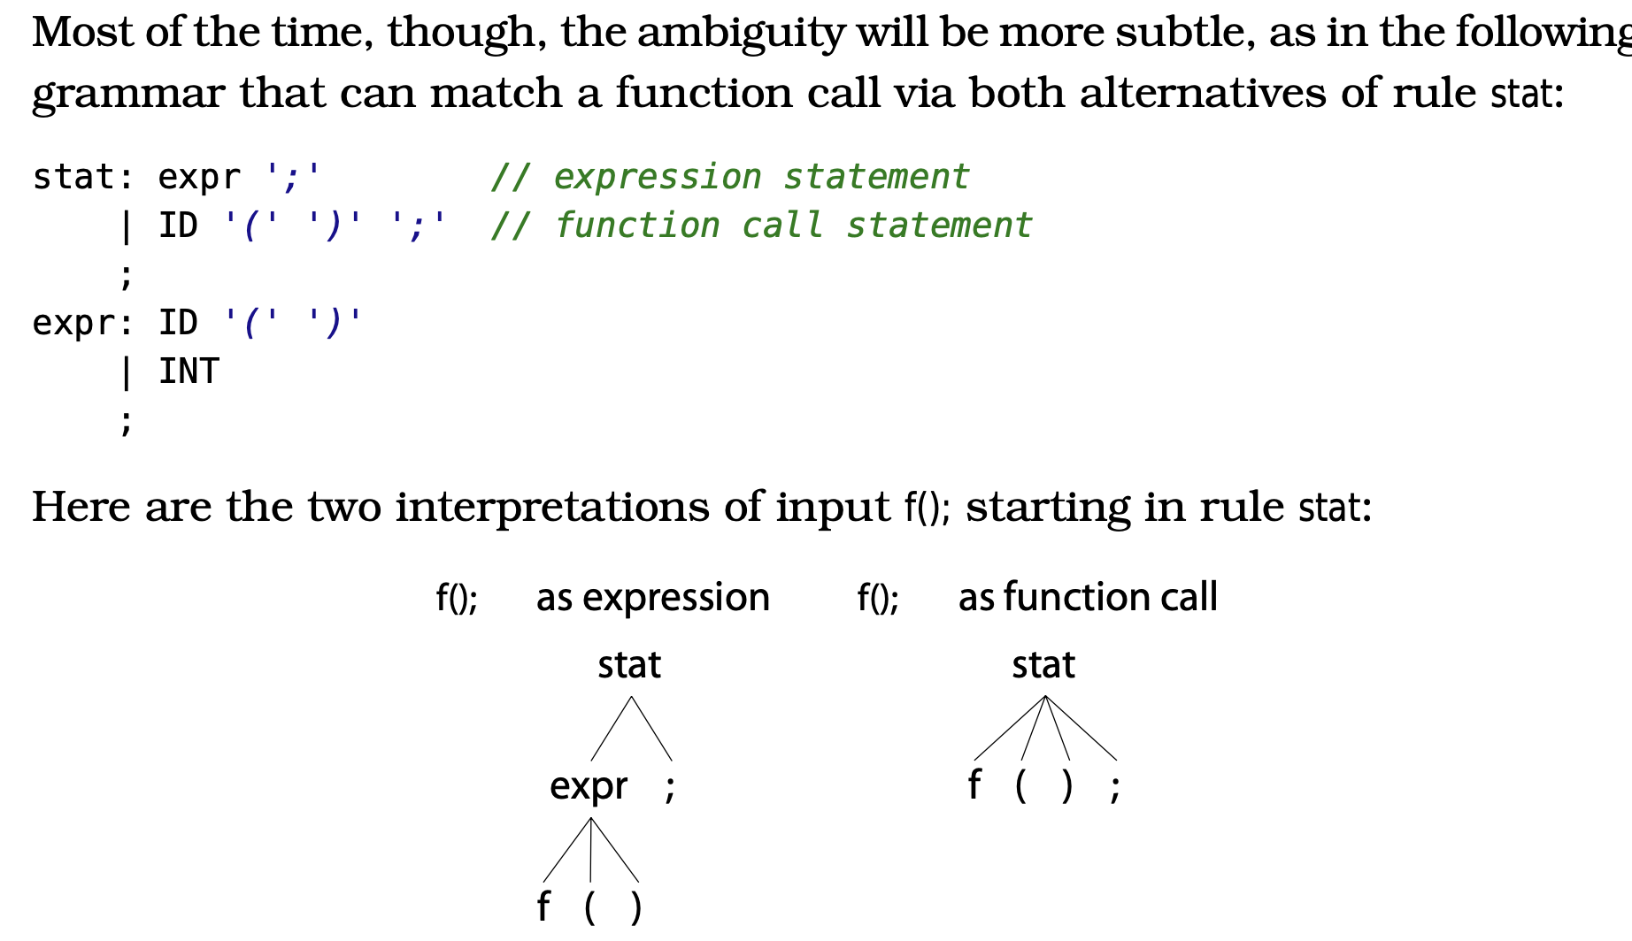
Ambiguity in Grammar
In Parser leftmost alternative is given preference if ambiguity arises and in lexer preference is given to to more specific rule or the rule that is defined above.

Slide 6
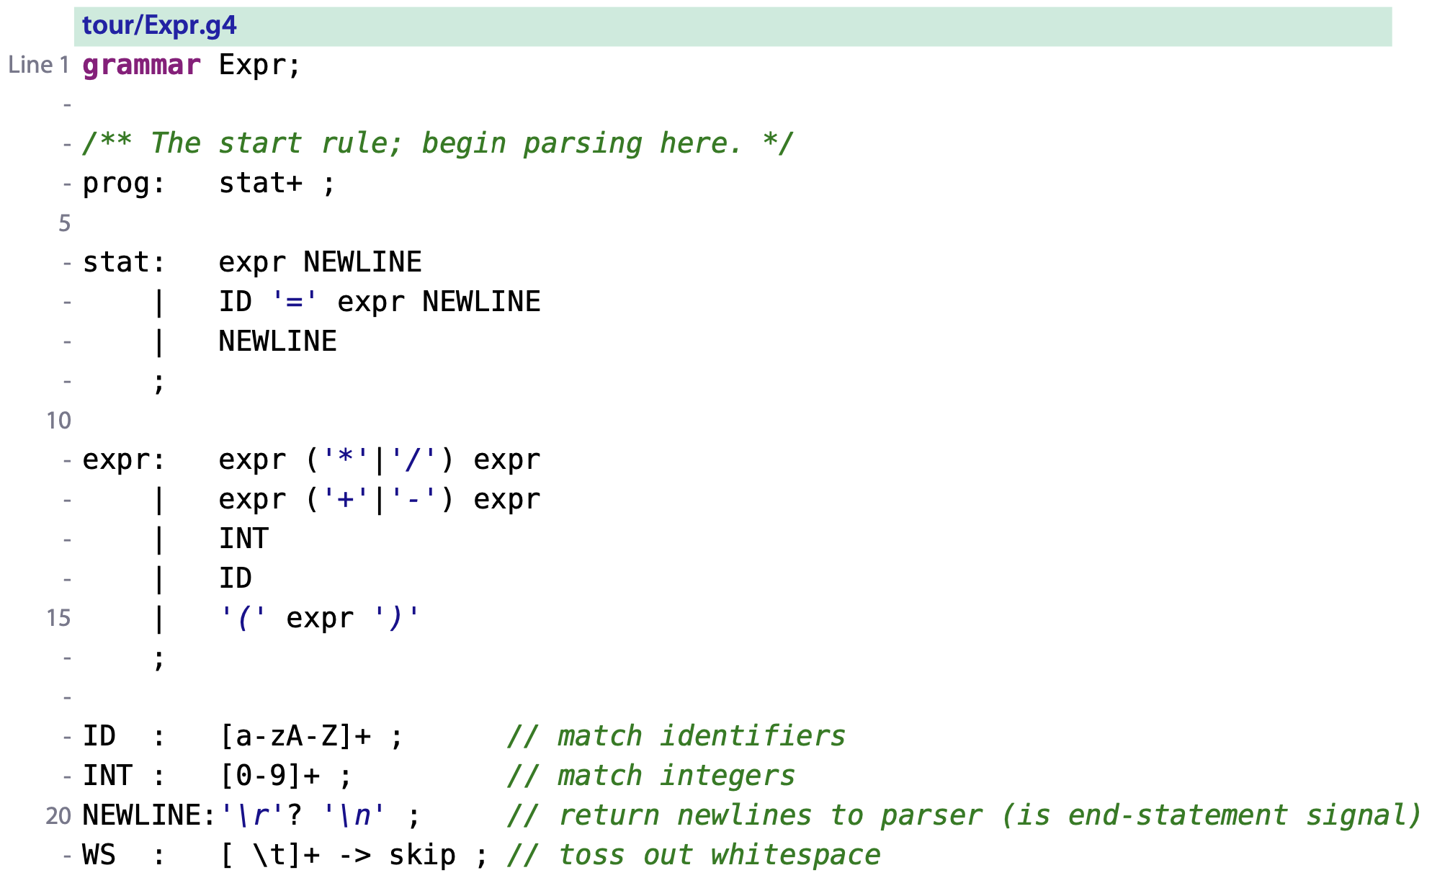
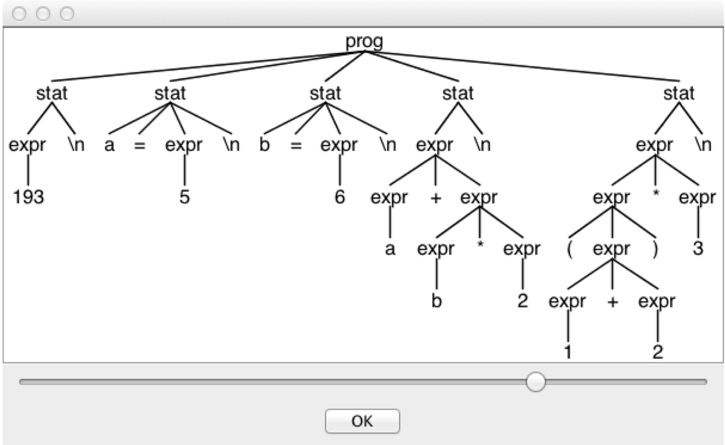
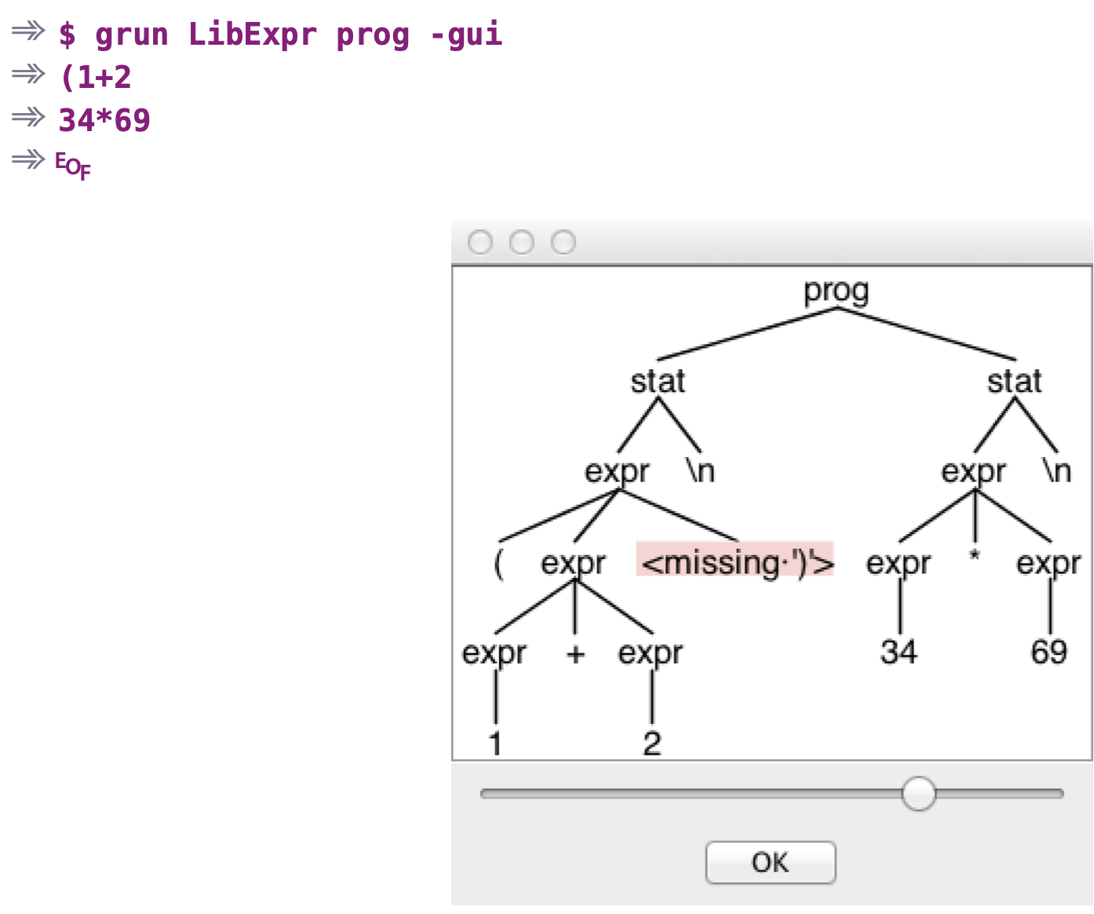
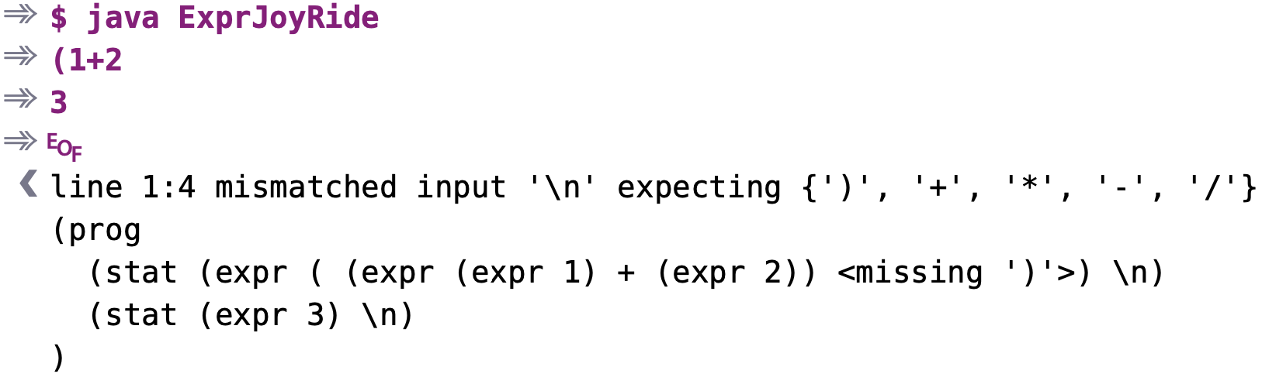
Calculator

Slide 7
Parsing JSON
https://github.com/antlr/grammars-v4/blob/master/json/JSON.g4
JSON (JavaScript Object Notation) is a lightweight, text-based data interchange format that is easy for humans to read and write, and easy for machines to parse and generate. It uses a simple syntax based on key/value pairs and ordered lists.
Key Components:
Objects: Collections of key/value pairs, enclosed in curly braces {}.
Arrays: Ordered lists of values, enclosed in square brackets [].
Values: Can be strings, numbers, booleans, null, objects, or arrays.

Slide 8
Parsing XML
XML (Extensible Markup Language) is a markup language used to store and transport data. It uses tags to define the structure and meaning of data, similar to HTML. However, XML is more flexible because you can define your own tags. It's commonly used for data interchange between different systems and applications, as it's both human-readable and machine-readable. XML documents consist of elements, attributes, and text content, organized in a hierarchical structure.

